Slide 1
IMPACT OF THE 2025 BUDGET ON THE BUSINESS AND ECONOMIC SECTOR
PRESENTATION BY
DR. MUDA YUSUF
CEO CENTRE FOR THE PROMOTION OF PRIVATE ENTERPRISE [CPPE]
AT THE NIGERIA ECONOMIC SOCIETY/NISER SEMINAR ON THE 2025 BUDGET
HELD ON 6TH MARCH 2025

Slide 2
PHILOSOPHY OF THE 2025 BUDGET
Restore macroeconomic stability.
Enhance the business environment.
Foster inclusive growth, employment, and poverty reduction
Promote equitable income distribution and human capital development.

Slide 3
STRUCTURE OF THE BUDGET
TOTAL FEDERAL BUDGET – N54.99 TRILLION
STATUTORY TRANSFERS – 3.65 TRILLION
RECURRENT NON-DEBT – 13.64 TRILLION
CAPITAL – 23.96 TRILLION
REVENUE PROJECTION – 40.88 TRILLION

Slide 4
REALISM OF BUDGET ASSUMPTIONS
INFLATION RATE AT 15%
OIL PRODUCTION AT 2.06 MBPD
OIL PRICE OF $75 PB
GDP GROWTH OF 4.6%
EXCHANGE RATE OF N1500/$

Slide 5
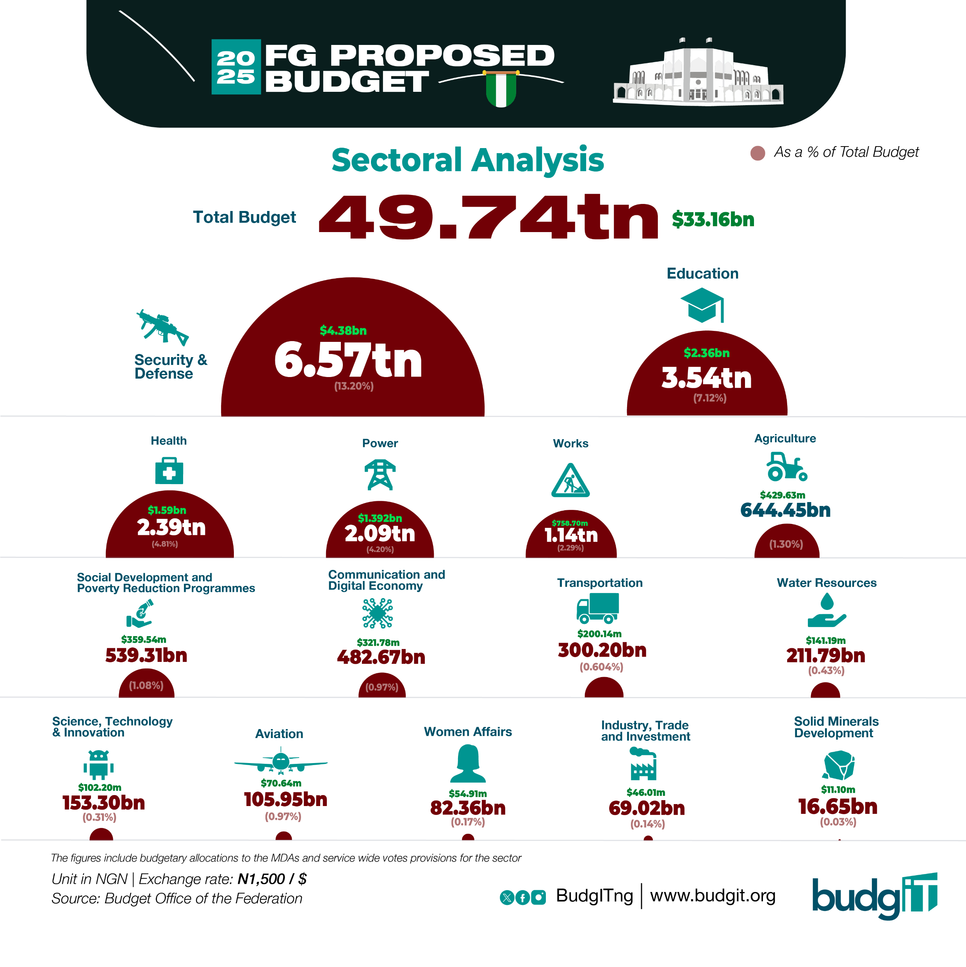

Slide 6
THE BUDGET, BUSINESS AND ECONOMY
THE BUDGET IS ESSENTIALLY A FISCAL APPROPRIATION INSTRUMENT – HOW GOVERNMENT REVENUES ARE SPENT TO ACHIEVE VARIOUS ECONOMIC AND SOCIAL OBJECTIVES.
NEED TO SITUATE THE CONVERSATION WITHIN THE CONTEXT OF PRIVATE SECTOR DESIRES IN THE ECONOMIC GOVERNANCE SPACE.
THIS IS WHAT WOULD DETERMINE THE VALUE OF BUDGETS TO THE PRIVATE SECTOR

Slide 7
BUSINESS IMPLICATION OF THE BUDGET
FIXING STRUCTURAL CHALLENGES THROUGH INFRASTRUCTURE SPENDING IN THE BUDGET. THIS COULD IMPACT POSITIVELY ON THE ECONOMY AND PRIVATE SECTOR.
BUSINESSES COULD BENEFIT FROM THE CONTRACTING AND PROCUREMENT ACTIVITIES AS SERVICE PROVIDERS OR SUPPLIERS ONCE SPENDING COMMENCES.

Slide 8
BUSINESS IMPLICATION OF THE BUDGET
HIGH GOVERNMENT BORROWING MAY HURT THE PRIVATE SECTOR BECAUSE OF THE CROWDING OUT EFFECT IN THE CREDIT MARKET BY GOVERNMENT.
FLIP SIDE OF BORROWING IS THAT IT OFFERS ATTRACTIVE LOW RISK INVESTMENT IN GOVERNMENT SECURITIES TO INVESTORS IN FINANCIAL INSTRUMENTS.
GOVERNMENT SPENDING PRIORITIES FOR SECURITY IS GOOD FOR THE INVESTMENT ENVIRONMENT.
GOVERNMENT HAS TYPICALLY HIGHER IMPACT IN SOCIAL SECTOR SPENDING – EDUCATION, HEALTH, ENVIRONMENT.

Slide 9
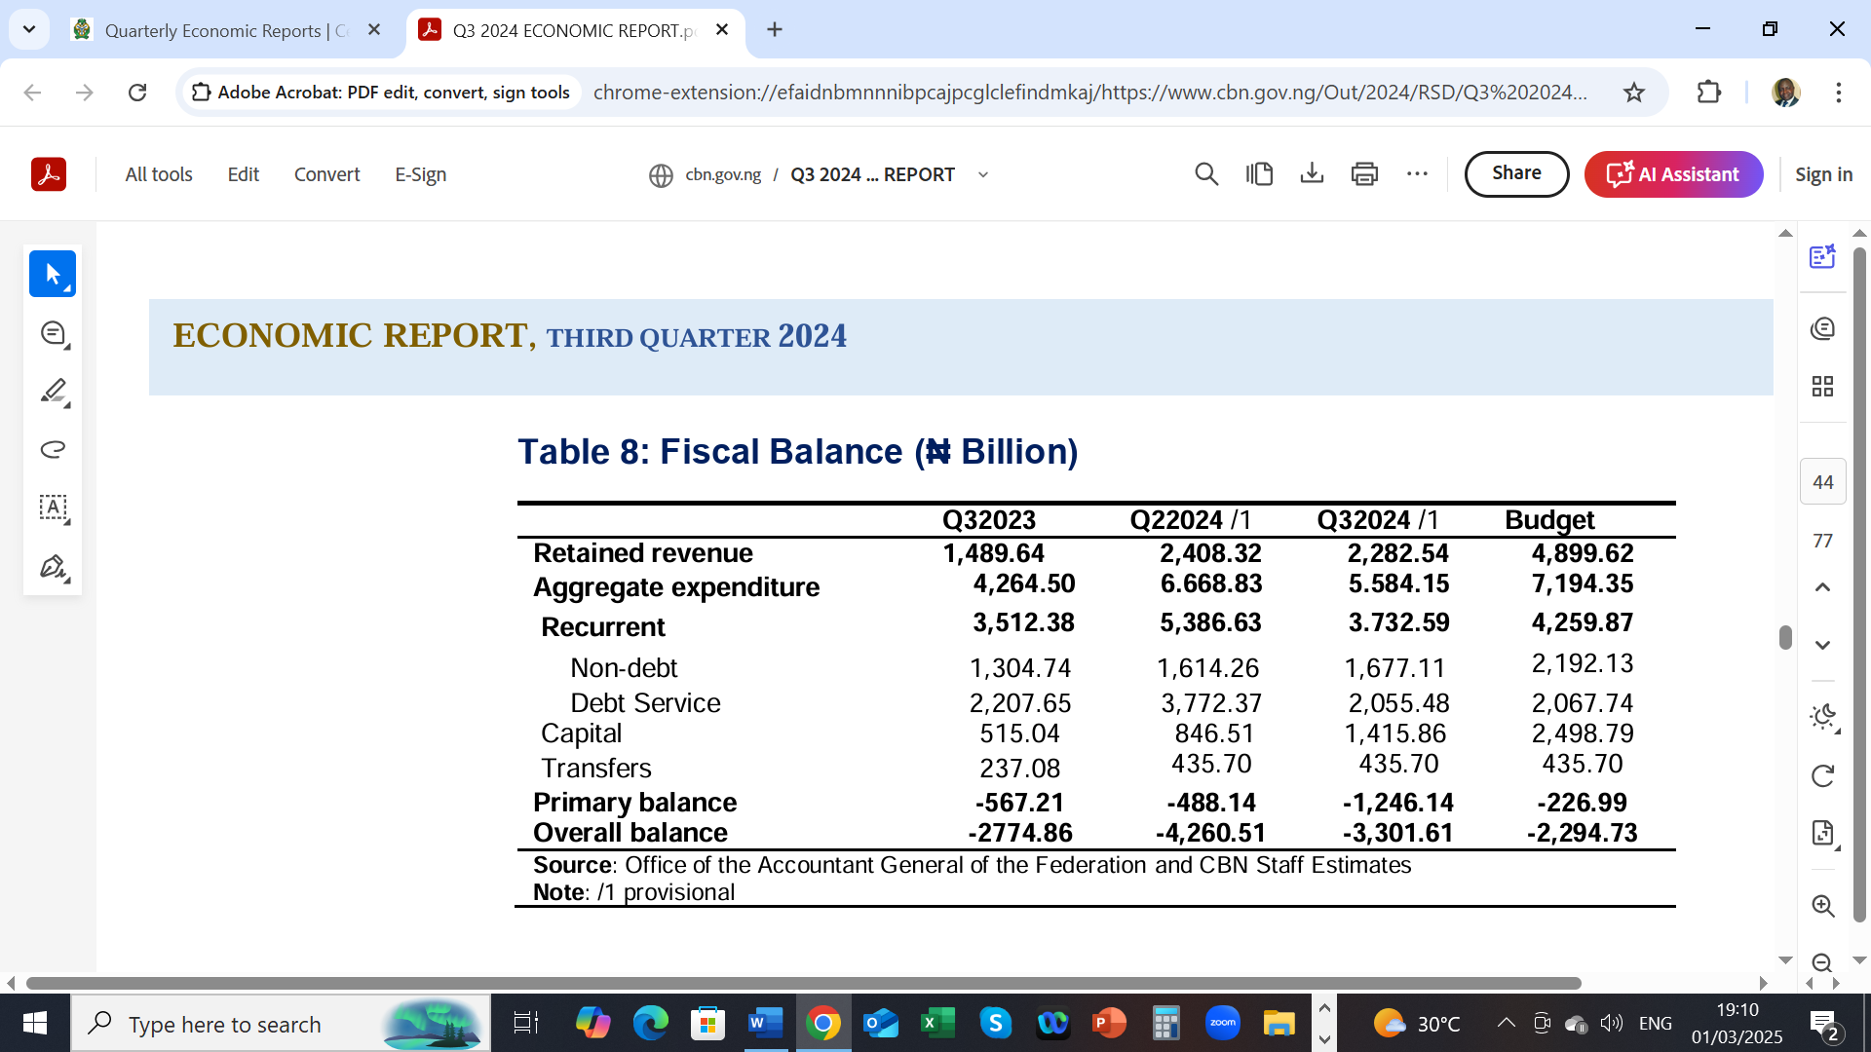

Slide 10
BUDGET IMPLEMENTATION CONCERNS.
THIS IS VERY CRITICAL FOR THE CREDIBILITY OF THE BUDGET AS AN INSTRUMENT OF APPROPRIATION AND ECONOMIC DEVELOPMENT.
THE 2023 CAPITAL BUDGET WAS INITIALLY ROLLED OVER TO JUNE 2024, THEN ROLLED OVER TO DECEMBER 2024
NOW THE 2024 BUDGET IMPLEMENTATION HAS BEEN ROLLED OVER TO JUNE 2025.

Slide 11
BUDGET IMPLEMENTATION CONCERNS.
AS OF THE FIRST QUARTER OF 2024, IMPLEMENTATION OF THE 2023 CAPITAL BUDGET WAS STILL ONGOING, WHILE THE AT OF 2024 WAS YET TO COMMENCE ACCORDING TO THE BUDGET IMPLEMENTATION REPORT OF THE BUDGET AND NATIONAL PLANNING MINISTRY
INEVITABLY, THE 2025 BUDGET WILL ALSO BE ROLLED OVER TO 2026.
WE NEED TO SEPARATE INFRASTRUCTURE SPENDING FROM THE CAPITAL BUDGET TO ENABLE A BETTER ASSESSMENT OF GOVERNMENT COMMITMENT TO INFRASTRUCTURE DEVELOPMENT, WHICH IS A MAJOR DESIRE OF THE PRIVATE SECTOR.

Slide 12
BUDGET OF SUBNATIONAL
THIS ALSO HAS SIGNIFICANT IMPACT ON STATES WITH PUBLIC SECTOR DOMINANCE. THESE ARE STATES WHERE THE MAJORITY OF THE FORMAL SECTOR WORKERS ARE CIVIL SERVANTS.
THE ECONOMIES OF THOSE STATES ARE TIED STRONGLY TO GOVERNMENT SPENDING – TEACHERS, CIVIL SERVANTS ETC.
STATES AND LGS HAVE MAJOR ROLES IN AGRICULTURAL AND RURAL SECTOR DEVELOPMENT
PRIMARY AND SECONDARY EDUCATION AND HEALTH CARE

Slide 13
KEY CONCERNS OF PRIVATE SECTOR
IT IS THE NEXUS BETWEEN THE BUDGET AND THESE KEY FACTORS THAT WOULD SHAPE THE VALUE PROPOSITION OF THE BUDGET FOR BUSINESS.
MACROECONOMIC STABILITY – LOW INFLATION AND STABLE EXCHANGE RATE.
CREDIT CONDITION - CURRENT INTEREST RATES ARE OUTRAGEOUS.
STRUCTURAL ISSUES IMPEDING PRODUCTIVITY AND COMPETITIVENESS OF BUSINESSES.

Slide 14
KEY CONCERNS OF THE PRIVATE SECTOR
LOGISTICS AND SUPPLY CHAIN ISSUES
TAX ENVIRONMENT – OFFICIAL AND UNOFFICIAL TAXES
CORRUPTION
REGULATORY ENVIRONMENT
SECURITY OF LIVES AND PROPERTY
JUSTICE DELIVERY SYSTEM/DISPUTE RESOLUTION.

Slide 15
KEY POLICY ISSUES OF CONCERN TO BUSINESS
FISCAL POLICY ISSUES
MONETARY POLICY
FOREIGN EXCHANGE POLICY
TRADE POLICY
ENERGY POLICY

Slide 16
DOMINANCE OF TAX AND DEBT IN FISCAL OPERATIONS
THE GOVERNMENT NEEDS TO REDUCE THE DEPENDENCE ON DEBT FINANCING BECAUSE OF THE BURDEN OF DEBT SERVICE.
DEBT SERVICE TO REVENUE RATIO IS TOO HIGH AND COULD IMPEDE ECONOMIC GROWTH.
THE COUNTRY’S ASSETS NEED TO BE BETTER OPTIMIZED FOR GOOD RETURNS
THE POLITICAL ECONOMY ISSUES REMAIN A MAJOR CONSTRAINING FACTOR.
MOFI NEEDS TO BE PROPERLY ACTIVATED.

Slide 17
CONCEPT OF MARKET FAILURE
NEED TO REALIZE THAT MARKET CANNOT FIX ALL ECONOMIC PROBLEMS.
THIS UNDERSCORES THE IMPERATIVE OF GOVERNMENT INTERVENTION IN SOME ASPECTS OF THE ECONOMY.
THE ROLE OF THE STATE IN INFRASTRUCTURE PROVISION, FOOD, HEALTH SERVICES AND POWER ARE CRITICAL TO DRIVE DEVELOPMENT.

Slide 18
CONCEPT OF MARKET FAILURE
THE STATE ALSO HAS A BIG ROLE TO PLAY IN THE PROVISION OF LONG-TERM FUNDS AND SINGLE-DIGIT LOAN FACILITIES IN THE REAL SECTOR IS IMPORTANT.
EXTREMES OF MARKET IDEOLOGIES SHOULD BE AVOIDED AS IT IMPOVERISH THE VULNERABLE SEGMENTS OF SOCIETY, ESPECIALLY WHERE THERE IS LIMITED SCOPE FOR COMPETITION.

Slide 19
FINANCIAL INTERMEDIATION
CURRENT MONETARY POLICY TIGHTENING REGIME IS CREATING A MAJOR CHALLENGE FOR FINANCIAL ROLE AND FINANCIAL INCLUSION IN THE ECONOMY.
CRR AT 50% AND LIQUIDITY RATIO AT 30% MEANS THAT ABOUT 80% OF DEPOSITS ARE NOT FULLY AVAILABLE FOR LENDING.
THIS HAS MEANT EXTREMELY HIGH INTEREST RATE, ONE OF THE HIGHEST GLOBALLY.

Slide 20
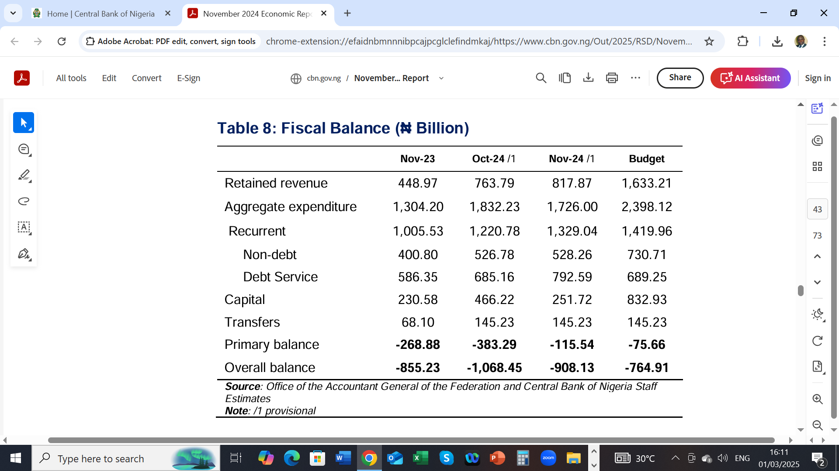

Slide 21
STYLIZED FACTS

Slide 33
ECONOMIC REFORMS

Slide 34
FLAGSHIP REFORMS
Foreign Exchange Policy Reform
Petrol subsidy removal/reduction
Monetary policy tightening by CBN
Fiscal Policy and Tax Reforms

Slide 35
FOREX REFORM: IMPLICATIONS FOR THE ECONOMY

Slide 37
Foreign Exchange Policy Reforms [Exchange Rate Convergence]
Benefits
Better transparency
Positive impact on forex liquidity in the short term.
Better prospects for forex inflow.
More revenue for government.
Better prospects for growth of non-oil sector.

Slide 38
FLIP SIDE OF FOREX REFORM
Depreciating Exchange Rate came with severe shocks on the economy.
Speculative pressures on the naira resulting from volatility at the onset of the reform.
Currency flight to the dollar as store of value.
Elevated uncertainty in business
Massive cost escalation across sectors

Slide 39
Implications for the Business
Cost escalation resulting from currency depreciation. Most budget items have foreign exchange content.
Worsened uncertainties in business
Higher risk of request for contract variation requests.
Risk of increased number of uncompleted projects.

Slide 40
Implications for Business[Contd]
Negative impact on citizens welfare worsening poverty conditions.
Need for more social intervention projects by the governemnts.
Weaker purchasing power
Positive impact – more revenue from FAAC resulting from increase forex exchange gains to the federation account which could be used to develop infrastructure

Slide 41
FX DYNAMICS 2025:
UPSIDES & RISKS

Slide 42
UPSIDES
Inflows from IMTOs have improved markedly.
Improvement in crude oil output following the more aggressive stance against crude oil theft.
Diaspora inflows also improving.
$500m Domestic Dollar bond oversubscribed, more to be issued.
$2 billion Eurobond recently issued was oversubscribed.
Foreign reserves now in excess of $40 billion
$7 billion Forex backlog obligations have been cleared
Debt service payments has steadied, no default
Fiscal deficit monetization has ended

Slide 43
UPSIDES
Import substitution effects of the Dangote refinery, and other domestic Refineries would be significant.
CBN consistent intervention in the forex market to ensure rate stability
Sustained monetary policy tightening.
Tighter CBN regulatory oversight to curb malpractices in the forex market
Elevated foreign portfolio inflows on the back of high interest rate

Slide 44
RISKS TO FOREX OUTLOOK
Outlook for crude oil price may be impacted by Trump presidency may lead to significant drop in crude oil price and forex earnings.
Stronger dollar likely on the back of Trump Presidency. Stronger dollar weakens naira exchange rate.
Likely rate hike in the first year of Trump Presidency as Trade wars may spike inflation in the US and the Federal Reserve may raise interest rates as a result.
Fiscal operations of government at all levels would increase and could trigger liquidity surge in the economy . Already a N49.7 trillion naira budget is proposed in the MTEF.
Fiscal deficit is likely to increase.

Slide 46
PETROL SUBSIDY REMOVAL/REDUCTION
Justification
Not fiscally sustainable
Too much leakages/corruption
Smuggling of petrol to neighbouring countries.
Challenge of monitoring.
Huge loss of revenue as NNPC could not remit funds to federation account.

Slide 47
PETROL SUBSIDY REMOVAL:
IMPACT ON ECONOMY, BUSINESS AND WELFARE

Slide 48
BENEFITS
NNPC remittance to federation account improved. This is expected to impact on FAAC allocation to states.
Reduced smuggling of petroleum products.
Eradicated the inherent corruption in fuel subsidy.

Slide 49
BENEFITS
Reduced domestic consumption from about 65 million litres daily to about 40 million litres
Outlook for private investment in the downstream is much brighter.
Conservation of foreign exchange as less fuel is imported.

Slide 50
FLIP SIDE OF FUEL SUBSIDY REMOVAL
The increase in PMS price by over 300% was a huge shock to the economy, investors and the citizens.
Triggered intense inflationary pressures because of sharp increases in transportation and operating costs.
Huge impact on the welfare of the citizens – food prices, transportation costs.

Slide 51
FLIP SIDE OF FUEL SUBSIDY REMOVAL
Poverty level increased.
Profit margins of many businesses were considerably eroded due to high operating costs which are not transferable to consumers.
High level of social discontent

Slide 52
MONETARY POLICY REFORM:
IMPLICATIONS FOR BUSINESS OUTLOOK IN 2025

Slide 53
Key Instruments of Monetary Policy
Monetary Policy Rate [MPR]
Liquidity Ratio
Cash Reserve Ratio [CRR]
Asymmetric Corridor around the MPR
Open Market Operation [OMO]

Slide 54
RECENT SHIFTS IN MONETARY POLICY
Unorthodox Monetary Policy under the Emefiele Regime
Return to Orthodox Monetary Policy under Cardoso regime

Slide 55
Features of Unorthodox Policy
Massive intervention funds to support various sectors – manufacturing, agriculture, health, aviation, SMEs, creative industry
Multiple exchange rates
Administrative allocation of forex,
Exclusion of 41 items from the official forex window

Slide 56
Features of Unorthodox Policy [Contd]
Embargo on over 300 bank accounts for alleged infractions
Bullish support for the real sector of the economy
Intervention in some strategic areas like creative industry, COVID, Health, Aviation, Power
Differentiated CRR to Support Real Sector

Slide 57
Features of Orthodox Monetary Policy
Floating of the currency to promote rate convergence
Scrapping of intervention funds
Market driven Interest rates
Inflation targeting policy
High interest rate to attract portfolio flows

Slide 59
Features of Orthodox Monetary Policy
Scrapping of exclusion of 41 items from official forex window.
IMTOs adopt willing buyer willing seller
Policy drive to achieve positive real interest rate.

Slide 60
OUTCOMES OF RETURN TO MONETARY POLICY ORTHODOXY
Sharp depreciation of the currency
Inflationary pressure
Better transparency
Improved liquidity in forex
High volatility

Slide 61
OUTCOMES OF RETURN TO MONETARY POLICY ORTHODOXY
Exit of multinationals as dollar returns contracted massively.
Huge forex losses by many large enterprises and multinationals
Escalation in Cost of doing business, cost of operations and cost of production.
Social cost very high leading to protests.

Slide 62
MONETARY POLICY TIGHTENING.
At the last MPC meeting held in Nov 2024, the CBN continued its monetary policy tightening stance to tackle inflation.
Monetary Policy Rate [MPR] was increased by 25 basis point from 27.25% to 27.5%.
Cash Reserve Ratio[CRR] of Deposit Money Banks was retained at 50%; and merchant banks at 15%
Retained Asymmetric Corridor around MPR at +500/-100 basis point.

Slide 64
Impact on Business
Cost of borrowing by investors and contractors would increase and this may increase business and project costs.
Debt service cost on domestic debt may increase.
High risk of loan defaults
Business sustainability vulnerable to elevated risks

Slide 65
TAX REFORMS: IMPLICATIONS FOR BUSINESS OUTLOOK IN 2025

Slide 66
TAX REFORMS
The Presidential Committee on Fiscal Policy and Tax Reforms is coming up with strategies to improve tax compliance by leveraging technology.
This may boost tax revenue to the federation account the benefit of which would cascade down to the sub nationals.

Slide 67
TAX REFORMS: IMPLICATIONS FOR BUSINESS
Reduction in Company Tax from 30% to 25%
Exemption of SMEs with turnover of N50 million and below from VAT and CIT
Abrogation of archaic Tax laws
Abrogation of nuisance taxes – wheel barrow tax, radio and television tax etc.
Introduction of Economic development tax incentives.
Rationalization of number of taxes.
Proposal to increase VAT from 7.5% to 10% commencing 2025

Slide 68
SILVER LINING IN THE CURRENT ECONOMIC REFORMS

Slide 69
OPPORTUNITIES IN THE CURRENT REFORMS
Significant opportunities for import substitution across all sectors.
Alternatives to industrial raw materials
Provision of domestic alternatives to medical tourism
Alternatives to education tourism
Alternatives to vacation abroad.
Local fabrications of spare parts and other mechanical devices.

Slide 70
OPPORTUNITIES IN THE REFORMS
Currency depreciation offers incredible incentives for Export business.
High food prices are a great opportunity for investment in agriculture.
Opportunities for diaspora Nigerians to invest at home.
Opportunities for export of services – Japa not entirely a bad idea. India had $125 billion remittances in 2023, Philippines $40 billion; China $50 billion; Mexico N67 billion , Nigeria $22 billion in 2022.

Slide 71
OPPORTUNITIES IN THE REFORMS
There should be deliberate policy to promote legal migration abroad. Even our artisans, care givers, truck drivers can benefit.
Outsourcing opportunities for business abroad.
Bigger Investment opportunities in the petroleum refineries and related industries following the deregulation of the sector.
Opportunities in renewable energy investment, cheaper and more environment friendly.
Better focus by investors and households on energy efficiency.
New opportunities in the use of CNG, LPG in transportation.

Slide 72
OPPORTUNITES IN ELECTRICITY SECTOR REFORM
Decentralization opens up opportunities in the entire electricity value chain.
Opportunities in embedded power solutions.
Opportunities in mini-grids.

Slide 73
ADAPTING TO CHANGING ECONOMIC AND BUSINESS LANDSCAPE

Slide 74
BUSINESS ENVIRONMENT DYNAMICS
The business landscape in Nigeria is very dynamic , driven by technological advancements, macroeconomic headwinds.
Regulatory issues and rapidly changing consumer behavior, driven by demographic changes and economic conditions have become critical for business strategy
These dynamics demand that business strategies are constantly reviewed to ensure relevance, resilience and competitiveness.

Slide 75
Flexibility of Business Models:
In a rapidly changing business landscape, flexibility of business model is vital for Nigerian businesses.
Being able to respond quickly to market trends, customer demands, and emerging opportunities is critical.

Slide 76
Scenario Planning
Scenario planning is critical for adaptation of business strategies to changing economic conditions.
We should construct scenarios for the critical variables that affect our businesses – exchange rate, inflation rate, interest rate, oil price, energy prices.
This should guide business decisions going forward as it allows for a proactive business decision.

Slide 77
Reduce Forex Exposure
Reduce exposure to forex as much as possible. Explore import substitution options as much as possible.
High forex exposure could endanger a business at this time.
Avoid offshore debt financing because of the weak currency and elevated exchange rate risk, except for export oriented industry. Many companies are paying a huge price for such exposures at this time
Aim for naira dominant balance sheet.

Slide 78
Reduce Debt Financing
Reduce exposure to commercial bank credit. Interest rate risks are very high at this time and this may persist for some time.
Prospects of monetary policy tightening at the domestic and global markets are very high. This could exert tremendous pressure on the business.
We should seek concessionary credit – BOI, BOA, SME Funds etc
Equity financing options should be explored more.

Slide 79
COST CONTAINMENT
Adaptation is also about managing cost to ensure resilience’s and competitiveness. It is thus imperative to identify costs that we can reduce.
We need to ensure a comprehensive cost audit to effect spending cuts in a way that would not negatively impact the business.

Slide 80
Cost Effective Energy Solution
Energy cost is a big issue at this time. We should therefore in energy solutions that are efficient and cost effective.
CNG, LPG, SOLAR, WIND ETC

Slide 81
Stakeholder Engagement
Stakeholder engagement is critical to manage the external environment such as regulatory authorities, security agencies, electricity suppliers, gas suppliers and the host community.

Slide 82
Leveraging Technology
Technology is crucial for the response and adaptation of businesses to the dynamics of evolving economic environment. Leveraging technology serves to optimize operations, enhance productivity, and deliver exceptional customer experiences.
Embracing digitalization, cloud computing, automation, and data analytics can help businesses streamline processes, improve decision-making, and gain a competitive edge. Moreover, technology enables businesses to reach a wider market and adapt to changing consumer behaviors in an increasingly digital world.

Slide 83
Embracing Innovation
Innovation is a key driver of business success in any evolving landscape. Organizations that promote a culture of innovation can proactively identify and create new opportunities.
This process could involve committing resources to research and development and supporting creative thinking. Value proposition is enhanced and competitiveness is improved.

Slide 84
Manage Volatility Risks
Long term contracts could indemnify against price volatility
Fixed sum contract could also protect against price volatility
Domestic currency pricing of contracts
Avoidance of offshore financing to reduce currency risk.

Slide 85
Manage Volatility Risks
Investment in government securities – government bonds and treasury bills.
Investment in forex denominated assets
Investment in real estate
Investment in Eurobond and similar financial instruments.
Businesses with high local content, minimum forex exposure.
Avoidance of debt financing because of high interest rate. Priorities equity financing. Or development financing windows – BOI, BOA, DBN
Export investment windows with minimum imported input to take advantage of weak currency.

Slide 86
Talent Development
The changing business landscape demands new talents that could readily align with the changing dynamics. Investment in talent development across the entire ecosystem is therefore imperative.
Talents drive creativity and innovation and also promotes competitiveness and resilience.

Slide 87
Strengthen Customer Focus
It is the understanding of customer preferences that can sustain a business.
Therefore, there should be good insights into the evolving customer priorities and preferences, regulatory monitoring of developments in the market, monitoring of competition environment, anticipating potential disruptions and periodic market research.

Slide 88
Strengthen Customer Focus
Other important commitments include customer feedback, information on industry trends, understanding market trends, good information on macroeconomic developments – exchange rate, inflation, energy pricing, changes in import tariffs.
Others are understanding of the cultural and social contexts; it is also useful to attend business events and exhibitions to be abreast of industry trends, online sources etc. There should be an adaptation plan.

Slide 89
Collaboration
Partnership and networking.
Partnership with complimentary product makers or sellers
Attendance at exhibitions and networking events.
Visit industry platforms online

Slide 90
THANK YOU

