Slide 1

CORRUPT BEHAVIOUR IN NIGERIA’S PUBLIC SECTOR: SIMPLIFYING A COMPLEX PHENOMENON
By
Dr Iyabo Olanrele
Dr Sebil Oshota
ABC Seminar Series
Nigerian Institute of Social and Economic Research (NISER)
16th November, 2023

Slide 2
Context
Different explainers for corruption in Nigeria (Anecdotal)
    A systems thinking approach to simplify the complexity of corruption in Nigeria
    This paper is a subset of a project “Research Support for Corruption Control through Behavioural Change”
SenseMaker (SM) Story Collection
    Lived experiences on corrupt behaviours
      2560 Citizens’ experience on corrupt practices in engagement with a public official
      614 Public officials experience of pressure to act corruptly
Quantitative data mined from 3,174 collections classified into demographics, agency involved, kind of corrupt behaviour, feelings evoked, effects of the act

Slide 3
Context
Prioritization of legal approach to corruption control in Nigeria is ineffective
    Set of legal fixes such as arrest, punishment, confiscation of assets acquired with proceeds
    Establishment of ICPC, EFCC, CCB, CCT, TSA, Whistle blower
    Yet, corruption deeply ingrained and institutionalized

Slide 4
Nigeria’s Corruption Perception Index and Rank (2013-2022)

Slide 5
Objectives
Systemic approach to corruption is needed to…
    Simplify the complex corrupt phenomenon by examining its various channels of social interactions and patterns
    Show emergent patterns of interactions that provide possible pathways for corruption control

Slide 6
Approach…
A departure from extant efforts using aggregate indices
    Use of granular information gathered through the SM tool to understand psychosocial elements of corruption
    SM data analysed using computational tool – the System Dynamics
    Employed to analyse a complex issue with interconnected structures, multiple players, fuzzy patterns- for effective policy making

Slide 7
Methodology
Data
  SenseMaker Survey of people’s lived experiences on the phenomenon
  Citizens – 2560 Nigeria’s in 14 states across the 6 geopolitical zones, and the FCT
  Institutional – 614 public officials across the country
  Frequency distribution of responses used to generate probability weights for model estimation
Modelling the complexity of corruption in Nigeria
  System Dynamics approach using the Vensim Software
  Modelling done with a causal loop diagram
  Calibrated with probability weights generated from SM survey data
  Scenarios for Corruption control measures were developed

Slide 8
Insights into SM Survey Data Distribution
Age distribution of respondents in the citizen’s survey

Slide 9
Insights into SM Survey Data Distribution
Distribution of Respondents by Gender

Slide 10
Insights into SM Survey Data Distribution
Employment Categorization of Respondents

Slide 11
Insights into SM Survey Data Distribution
Gender Representation in Institutional Survey

Slide 12
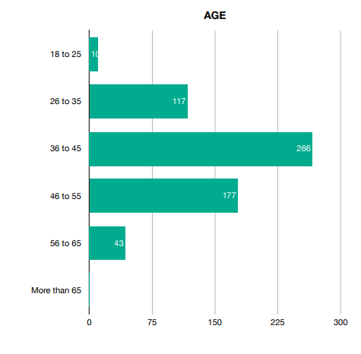
Insights into SM Survey Data Distribution
Distribution of age groups of respondents in Institutional Survey

Slide 13
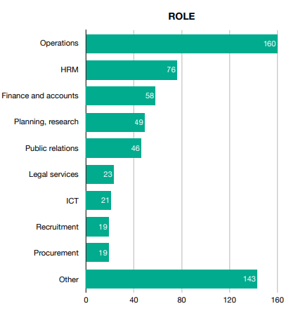
Insights into SM Survey Data Distribution
Distribution of Professional Profile

Slide 14
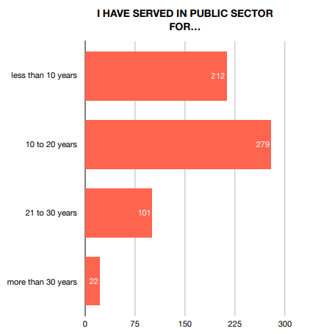
Insights into SM Survey Data Distribution
Years of experience of respondents in Institutional Survey

Slide 15

Results

Slide 16
Situational Description of Corruption in Nigeria
Typologies of corrupt practices experienced by citizens

Slide 17
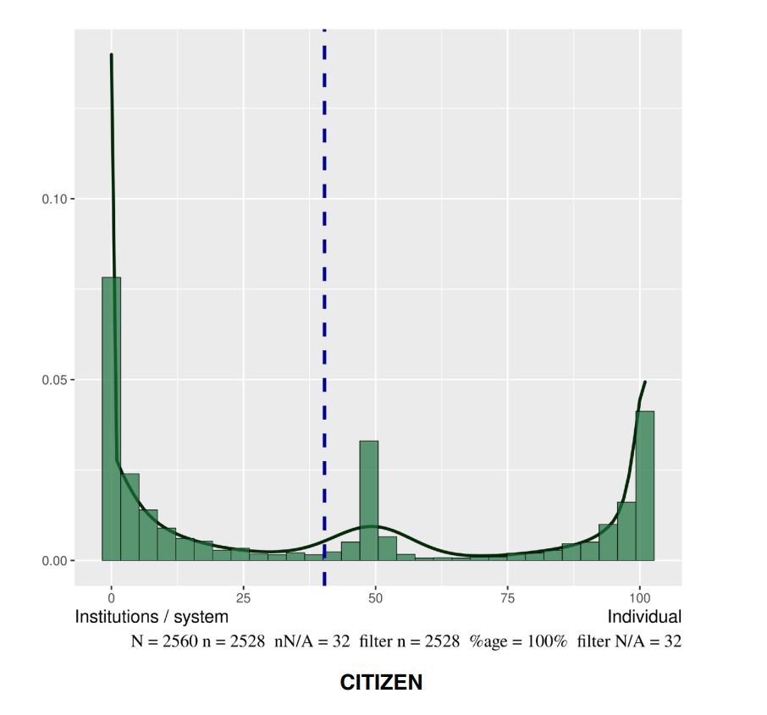
Situational Description of Corruption in Nigeria
Situating Corruption at Systemic or Individual level

Slide 18
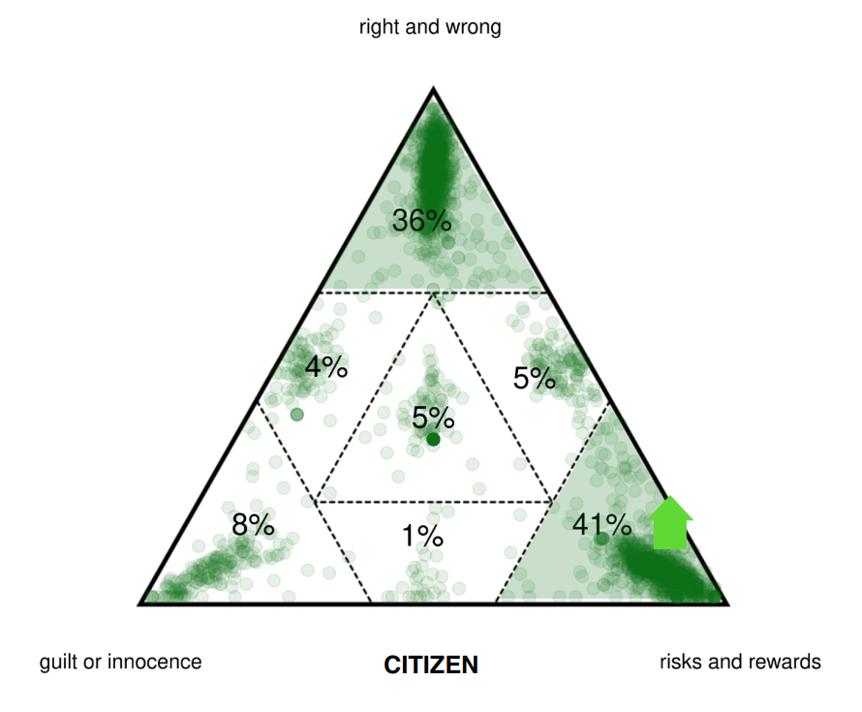
Situational Description of Corruption in Nigeria
Corruption as a Function of Motivating Factors

Slide 19
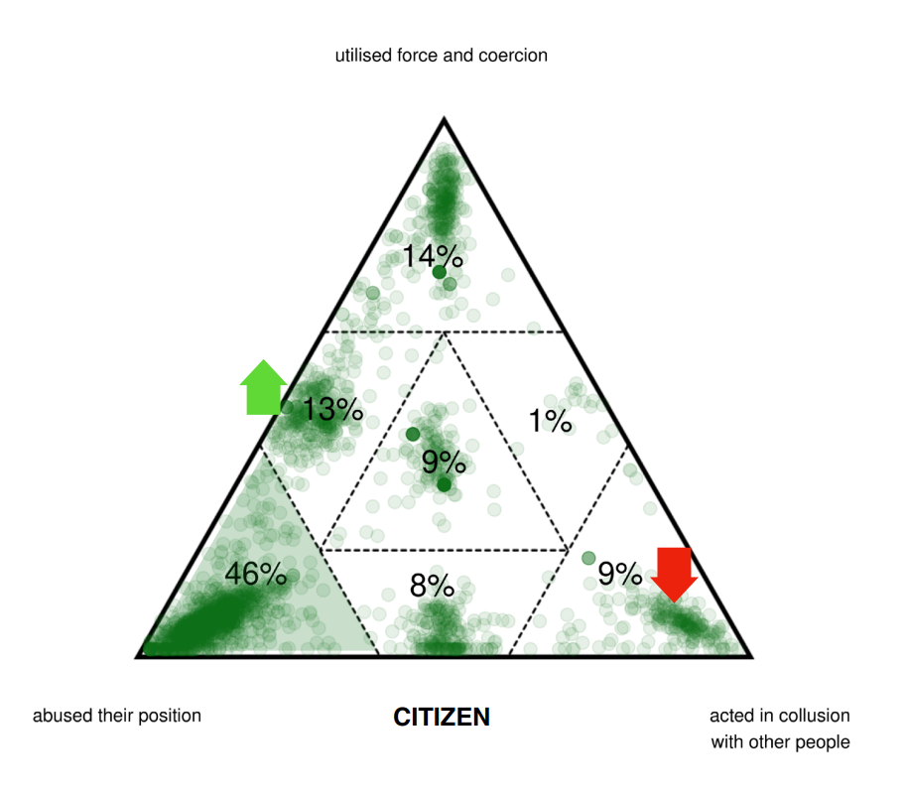
Situational Description of Corruption in Nigeria
Corruption as a dimension of Power Dynamics

Slide 20
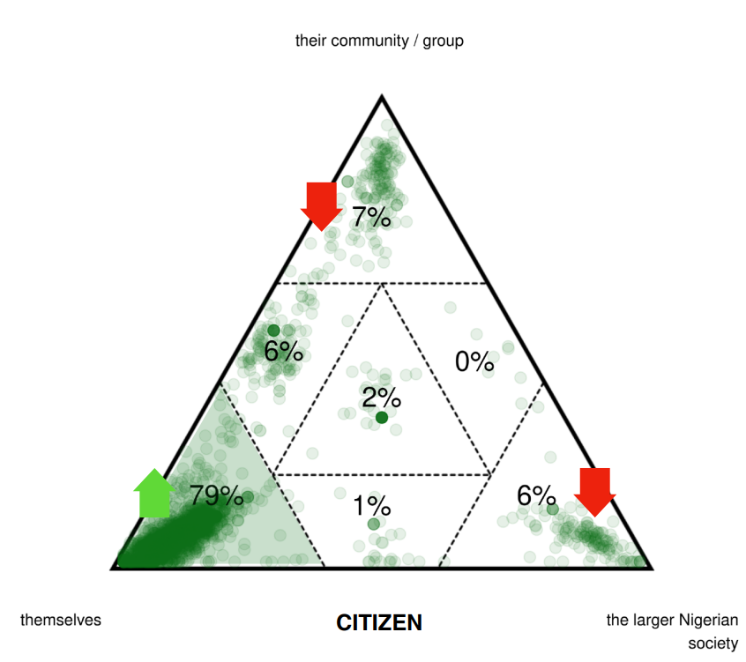
Situational Description of Corruption in Nigeria
The role of Identity in Corruption

Slide 21
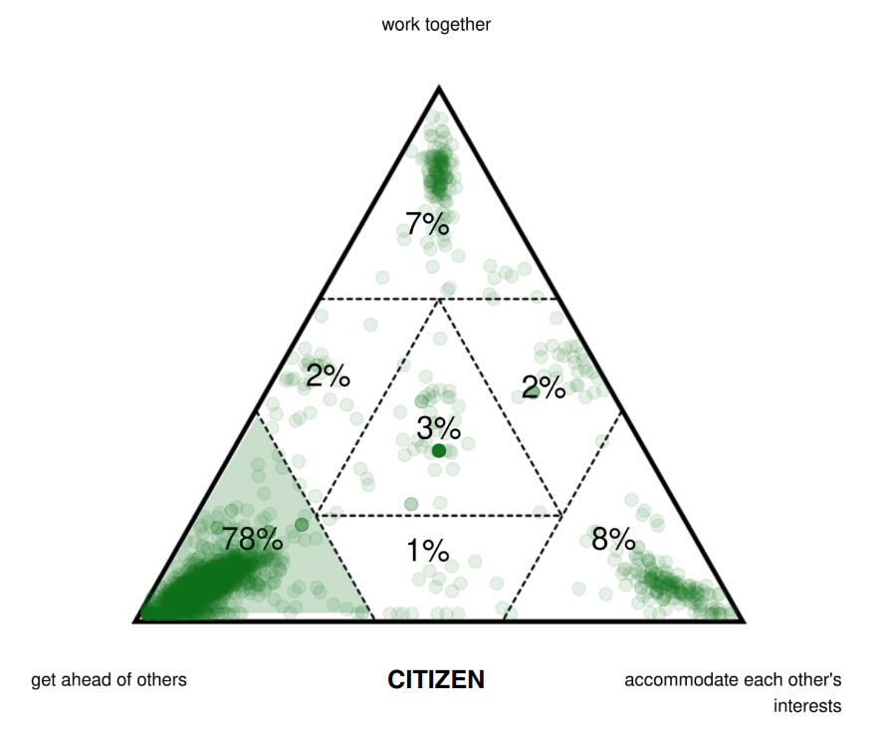
Situational Description of Corruption in Nigeria
The role of Social Relations in Corruption

Slide 22
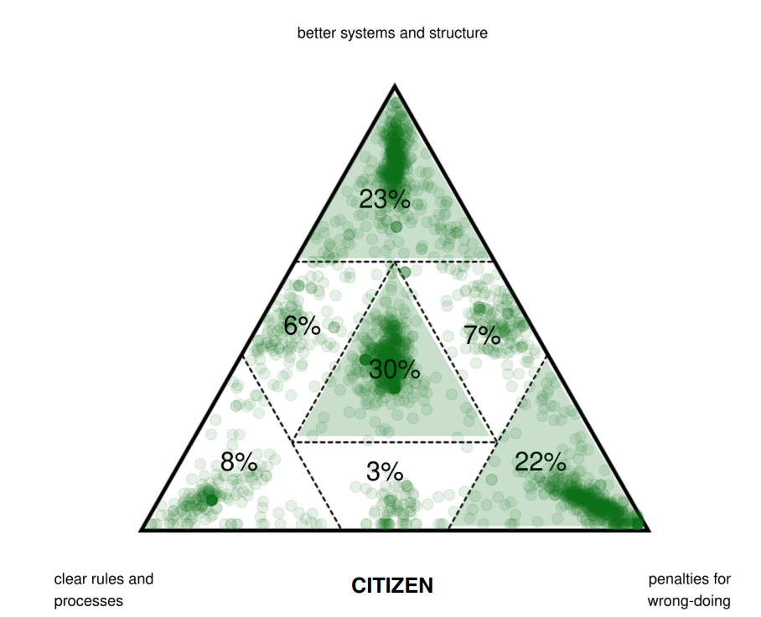
Situational Description of Corruption in Nigeria
Strategies for Corruption Control

Slide 23
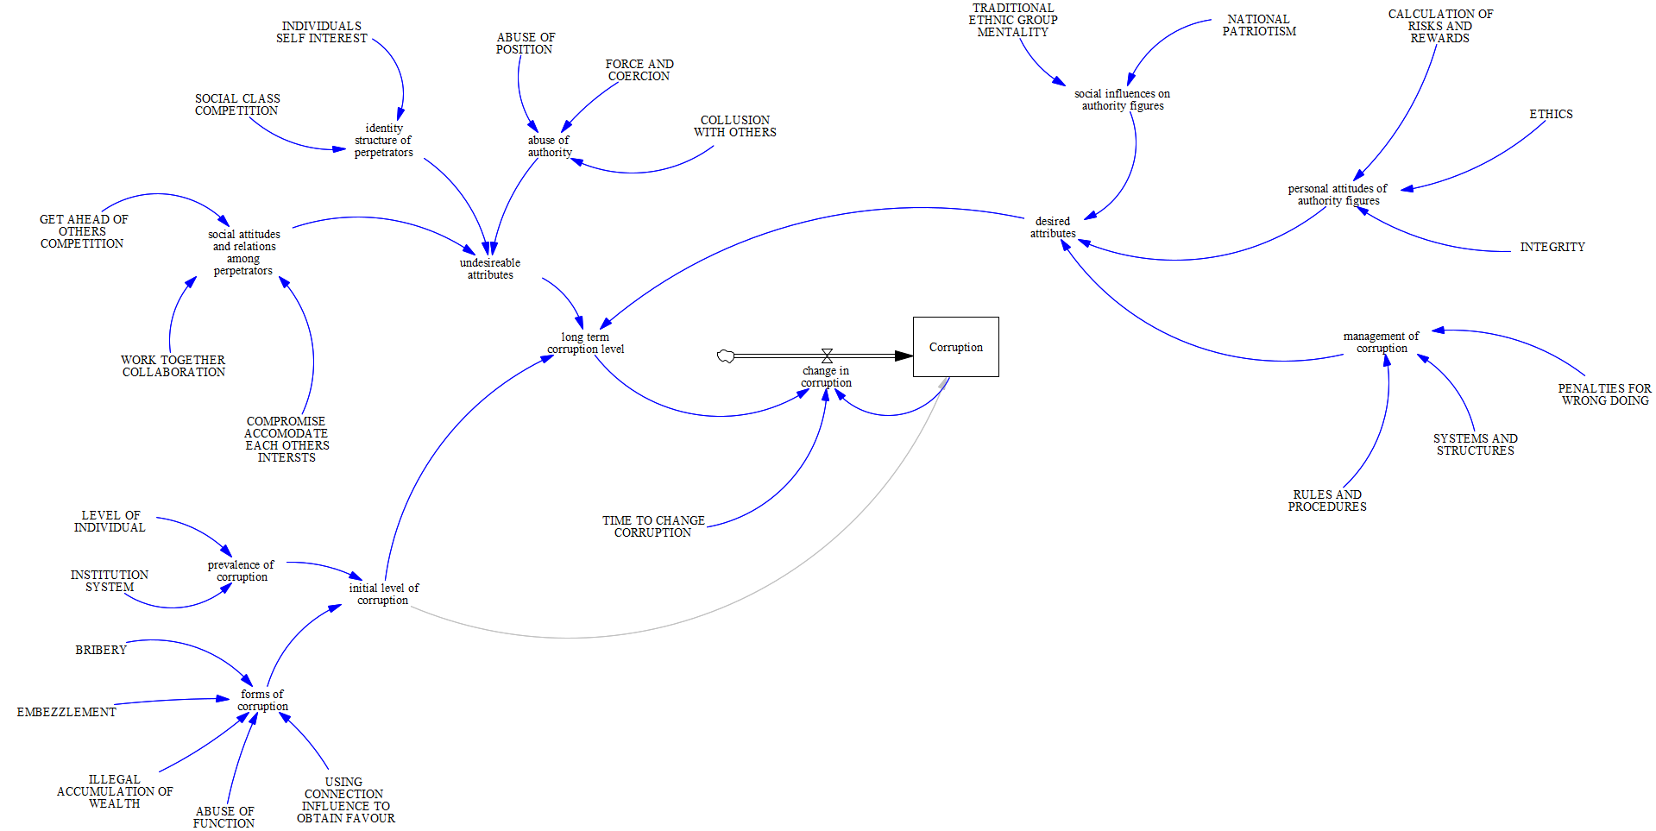
Citizen System Dynamic Model of Corruption

Slide 24
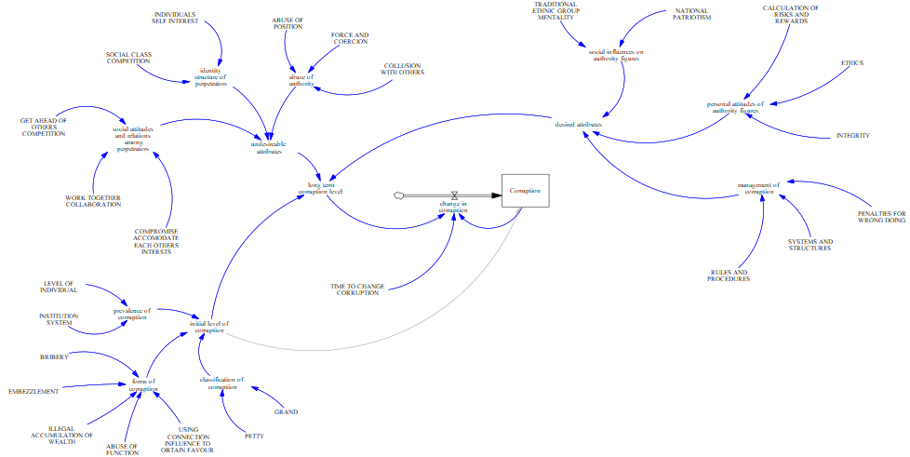
Institutional System Dynamic Model of Corruption
Difference is the inclusion of classifying corruption into grand and petty at the Institutional level

Slide 25
Scenario Analysis
  Dynamic Models (in the methodology) were calibrated using the probability weights generated from the SenseMaker survey
  Ex-ante simulation of corruption control measures over a 10-years period
    Impacts of policies/interventions that alter behavioural norms (such as those implied in corrupt behavior) takes time to manifest significant changes
  25% change across some selected desirable attributes and undesirable attribute
      Inputs that generate changes in the corruption phenomenon
    Results are presented as scenario outcomes below

Slide 26
Scenario Analysis
Assumption:
A favorable condition when there is 25% increase in NATIONAL PATRIOTISM…
  RELATIVE CORRUPTION decreases
An undesired condition/attribute occurs such that there is a 25% increase in ABUSE OF POSITION…
RELATIVE CORRUPTION increases
When there is a 25% increase in both NATIONAL PATRIOTISM and ABUSE OF POSITION
    Both changes cancel each other out and RELATIVE CORRUPTION remains at the initial value (unchanged: see Scenario 1).

Slide 27
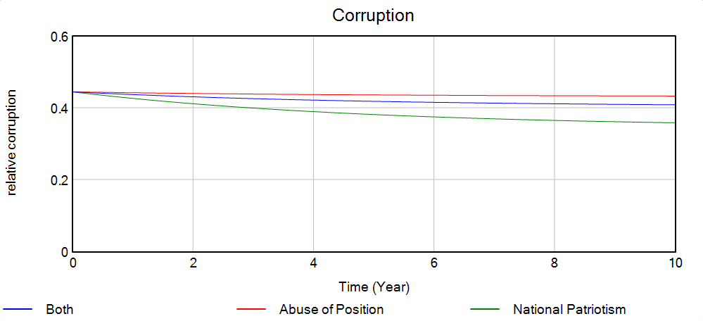
Simulation Result
Scenario 1:

Slide 28
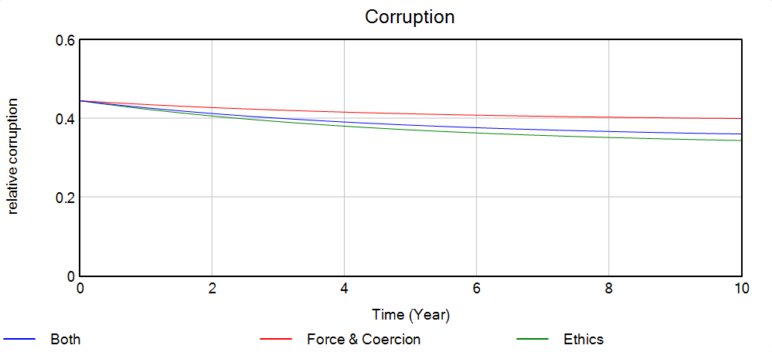
Simulation Result
Scenario 2

Slide 29
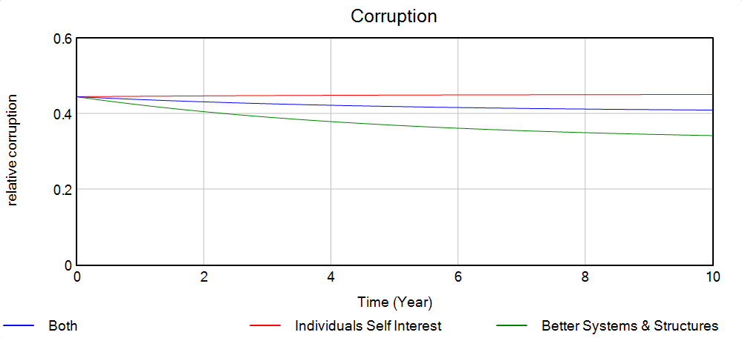
Simulation Result
Scenario 3

Slide 30
Key Messages
Effective corruption control requires an adaptive understanding of underlying psychosocial constructs
Corruption control strategies has to be significant and holistic, rather than a single control mechanism
Simultaneously provide levers that engender significant positive behavioural changes across undesirable attributes
Efforts towards corruption control has to be intense, and enforcement has to be strong and vigorous

Slide 31
Thank You for listening

