Slide 1
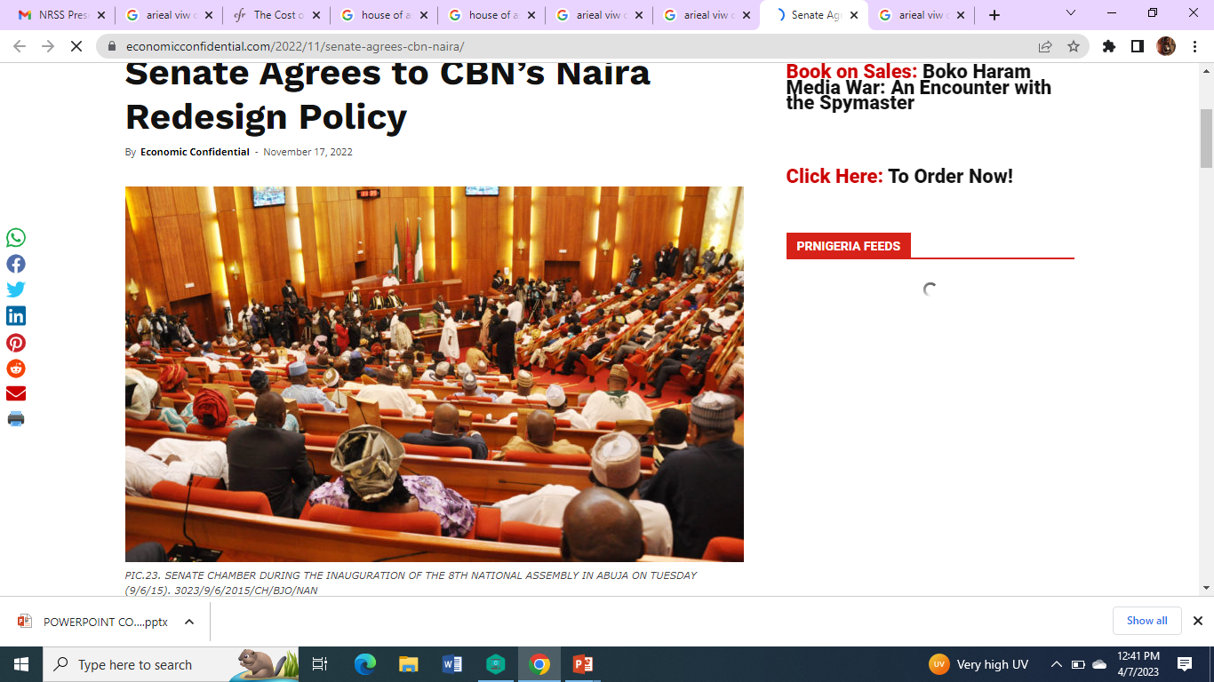
COST OF GOVERNANCE AND DEVELOPMENT IN NIGERIA
Presented by
Louis Chete and
Abubakar Oladeji
NISER Research Seminar Series (NRSS)

Slide 2
PROLOGUE
Undercurrents
A
INTERDISCIPLINARY COLLABO BETWEEN PGPD AND EBPD
B
B
D

Slide 3
GRAVAMEN OF THE ARGUMENT
01
Is high CoG a decelerator of development?
02
2 pillars – High CoG, Development loss
Political Dimension
Economic Dimension
LINEAR
Linear

Slide 4
Introduction
“Successful growth and development require the presence of a development
bargain-that is, an underlying commitment to growth and development by
members of a country’s elite” (Stefan Dercon,2022).
Dercon insists on the imperative of development bargains
Elites-political and economic- commit class suicide
Committing elite suicide (‘be born again’) means that the elite will deliberately make the decision not to feather their own nest with enormous resources that country has to instigate growth (Olaopa, 2022: 15).

Slide 5
Introduction
Intense conversations around the huge cost of governance in Nigeria.
Spiralling recurrent spending and corresponding dwindling capital share
In 2010, a former Governor of the CBN talked about a lopsided 70:30 ratio in favour of recurrent expenditure
That only 25 per cent of overhead cost is consumed by the NASS
Structural and constitutional imperatives of federal presidential democracy, as well as the idiosyncrasies of political elites.

Slide 6
Introduction
Cost of running a federal presidential system ?
Constitution creates multiple offices
Appointment of large numbers of aides
Staggering emoluments of political office holders
Imbalance between recurrent and capital expenditure!

Slide 7
Consequently…
Nigeria’s score on virtually all development indicators is extremely low:
Human Development Index (HDI)
Gini coefficient
GDP per capita
Literacy level
Life expectancy
Poverty rate.

Slide 8
Research Objectives
The overall objective of this study is to analyze the effects of cost of governance on development at the federal level in Nigeria.
The specific objectives are to:
  Assess factors responsible for the perceived high cost of governance at the federal government level in Nigeria.
  Examine the structure of governance at the federal level in Nigeria.
  Undertake a comparative analysis of the cost of governance in Nigeria and selected federal democracies in developing and advanced countries.
  Estimate the effects of the cost of governance on development in Nigeria.

Slide 9
Factors Responsible for High Cost of Governance in Nigeria
Massive Salaries and Allowances of Public Office Holders
Maintenance of Large Number of Aides by Government Officials
Expensive Democracy and Huge amount spent to Conduct of Elections
High Level of Corruption and Mismanagement of Public Funds

Slide 10
Factors… (Contd.)
Duplication of MDA- There are approximately 541 public corporations and agencies owned by the Federal Government
Over 5,000 persons needed to man the corporations and agencies;
personnel and overheads budget for running these agencies runs into trillions of naira.

Slide 11
Number of MDAs and State-Owned Corporations
Sources: Data culled from the Federal Civil Service Commission website and Other Sources

Slide 12
Governance Structure
The Nigerian Federal System-A multi-layered structure
Different tiers with distinct functions and powers.
Most of the constitutional or governmental powers allocated to the central government, making it the dominant power.
A presidential system of government is also adopted- three main branches of government differently composed.

Slide 13
Governance Structure Under Presidential System (1979-1983 & 1999 to date)
The 1999 Constitution provided for the current governance structure in the country.
The structure consists of a federal government, 36 federating units and a federal capital, and 774 local governments.
At the federal level, governance is conducted through three organs: the executive, the legislative, and the judiciary

Slide 14
Governance Structure
The executive powers of the Federation are vested in the President and can be exercised on his/her behalf by the VP or a Minister.
The President is the Head of State, Chief Executive, and the Commander-in-Chief of the Armed Forces.
The Constitution compels the President to apply the principle of Federal Character in appointing ministers. Thus, the President must appoint at least one minister from each state who is an indigene of those states.
Attached to the executive arms are 14 Federal Executive Bodies.
Nigeria operates a bicameral legislature-the Senate and the HoR Federation”.

Slide 15
Comparative Perspective
S/N | State | Head of State Annual Salary ($US) | GDP Per capita ($US) | Salary of Head of State as % GDP Per capita | Minimum Wage Annual Salary ($US) | Minimum Wage as % of GDP per capita
1 | India | 15,000 (Prime Minister) | 7,334 | 205 | 674 | 38
2 | South Africa | 223,500 (President) | 14,420 | 1248 | 3,671 | 78.2
3 | United States | 400,000 (President) | 69,288 | 577 | 15,080 | 26.2
4 | Canada | 290,000 (Prime Minister) | 52,085 | 542 | 24,128 | 49.5
5 | Mexico | 67,903 (President) | 20,037 | 335 | 3,104 | 36
6 | Brazil | 102,524 (President) | 16,056 | 430 | 2,923 | 47.6
7 | Nigeria | 69,000 (President) | 5,459 | 145 | 901 | 49.7

Slide 16
Comparative Perspective (contd.)
The minimum wage in sampled countries is a small fraction of government spending, and the President's salary as a share of GDP is high in countries such as South Africa, Canada, and Nigeria.
In Nigeria, the President's salary may seem modest, but there are significant "hidden" allowances (also for legislators, such as operating expenses, salary and benefits, and constituency projects, with additional allowances for housing, clothing, furniture, among others . not mentioned in official statements).

Slide 17
Annual Earnings of Lawmakers in Selected Countries
Source: Eme and Okeke (2014); Oxfam International (2017)

Slide 18
GOVERNANCE STRUCTURE: US Vs NIGERIA
UNITED STATES
NIGERIA
100 Senators
435 House of Rep members
Larger federation with 50 states
Largest economy in the world by GDP
3rd largest population in the world
12 ministers
109 Senators
360 House of Rep members
Smaller federation with 36 states
26th largest economy in the world by GDP
7th largest population in the world
Over 40 ministers

Slide 19
ECONOMIC DIMENSION

Slide 20
Notions of cost
Capital Item | Recurrent item
A new school facility | GOOD Teachers’ salaries Textbooks and teaching materials Electricity, petrol, and other costs to run the facility. Regular and periodic maintenance costs Teacher training
Technocratic Notion (money, expenditure)
Academic (forgone alternative, development loss)
Metric of CoG (closest approx: Recurrent expenditure)
Cautionary note:
Recurrent (CoG) – Good, Bad, Ugly?
BAD
Misuse of public funds,
Payroll padding (Ghost workers)
Contract-splitting;
Questionable foreign travels;
Bogus security votes

Slide 21

Methods of analysis
Descriptive analysis
  Growth rates
Share percentages
Modelling
    Recurrent expenditure model
Administrative expenditure model

Slide 22
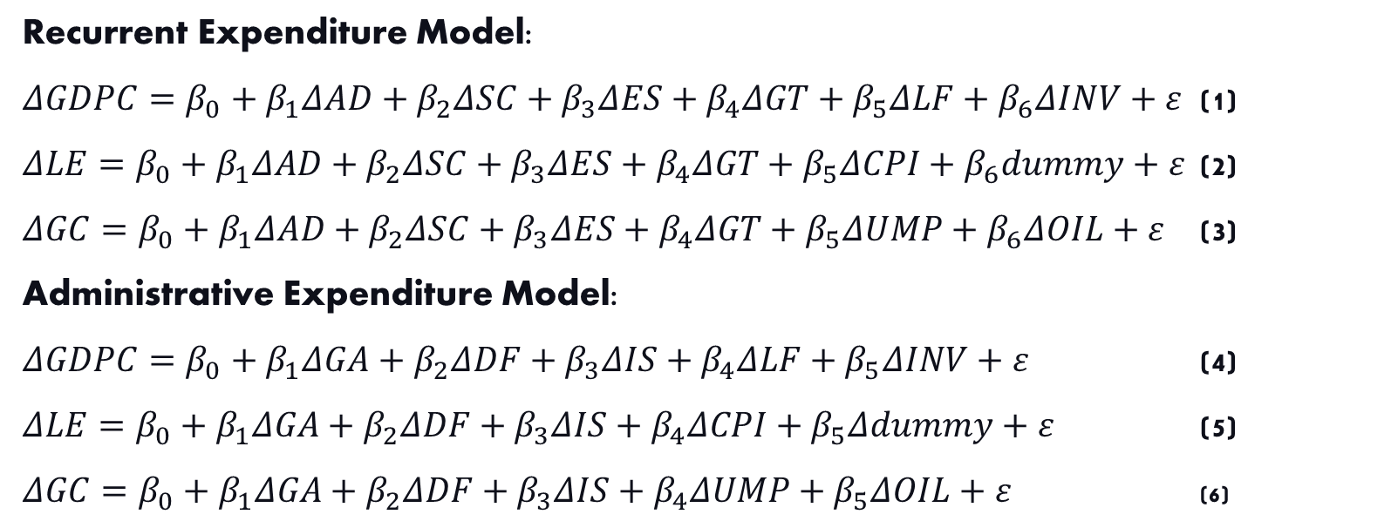
MODELS
Recurrent Expenditure Model:
$ΔGDPC=β_{0}+β_{1}ΔAD+β_{2}ΔSC+β_{3}ΔES+β_{4}ΔGT+β_{5}ΔLF+β_{6}ΔINV+ε$ (1)
$ΔLE=β_{0}+β_{1}ΔAD+β_{2}ΔSC+β_{3}ΔES+β_{4}ΔGT+β_{5}ΔCPI+β_{6}dummy+ε$ (2)
$ΔGC=β_{0}+β_{1}ΔAD+β_{2}ΔSC+β_{3}ΔES+β_{4}ΔGT+β_{5}ΔUMP+β_{6}ΔOIL+ε$ (3)
Administrative Expenditure Model:
$ΔGDPC=β_{0}+β_{1}ΔGA+β_{2}ΔDF+β_{3}ΔIS+β_{4}ΔLF+β_{5}ΔINV+ε$ (4)
$ΔLE=β_{0}+β_{1}ΔGA+β_{2}ΔDF+β_{3}ΔIS+β_{4}ΔCPI+β_{5}Δdummy+ε$ (5)
$ΔGC=β_{0}+β_{1}ΔGA+β_{2}ΔDF+β_{3}ΔIS+β_{4}ΔUMP+β_{5}ΔOIL+ε$ (6)

Slide 23
DEFINITION OF VARIABLES
GDPpc is GDP per capita,
LE, life expectancy,
GC, Gini coefficient,
AD, administrative expenses,
SC, social community services,
ES, economic services,
GT, government transfer,
POLDUM to capture political reforms
GA, general administrative expenses,
DE, expenses on defence,
IS, expenses on internal security,
LF, labour force,
INV, investment,
UMP, unemployment rate,
CPI, consumer price index,
OIL, oil revenue, and
Dummy (poldum)
Annual time series spanning 1981 to 2021 is used to estimate the model

Slide 24
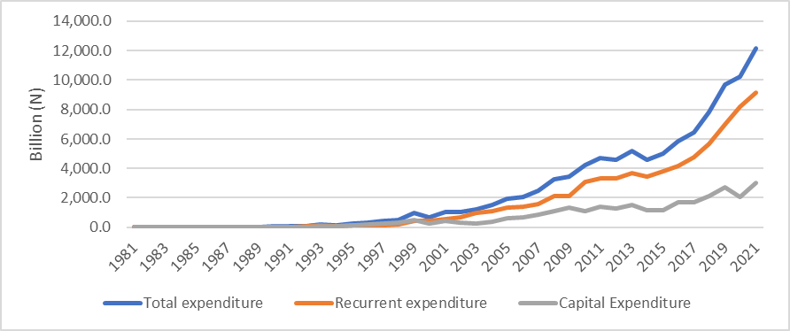
Expenditure Profile of Federal Government (1981-2021)
Source: CBN Statistical Bulletin 2022
Sharp upturn in 1999 Upward trajectory since then CAPEX RECEX TOTEX RECEX>CAPEX

Slide 25
Percentage Changes of Federal Recurrent Expenditure (1982-2021)
Source: CBN Statistical Bulletin 2022
Spikes and Volatility Boom & bust effect Subdued in latter years

Slide 26
Growth in Federal Government Personnel Costs: 2016 - 2022
Source: Federal Ministry of Finance
Quickened for the most part Accelerated in the COVID- 19/Oil slump period

Slide 27
Shares of Capital and Recurrent in Total Expenditure (%)
Source: CBN Statistical Bulletin

Slide 28
Share of Administration in Total Recurrent Expenditure. Source: CBN Statistical Bulletin

Slide 29
Share of Economic Services Capital component (% of Total): 1999-2021
Source: CBN Statistical Bulletin
Decent share Literally stagnant subsequently

Slide 30
Share of Social and Community Services Capital component (% of Total): 1999-2021
Source: CBN Statistical Bulletin
Big shares in 2003, 2007 Plunged thereafter Again, largely flat in recent years Modest rise in 2021

Slide 31
Share of Transfers Capital component (% of Total): 1999-2021
Source: CBN Statistical Bulletin
Debt relief effect from a high of 22.99% in 1999 Return to the pre-debt level in 2011 Averaging 19% of total capital in recent years

Slide 32
Average growth rate of federal administrative and recurrent expenditure by regime (1999-2021)
Obasanjo – highest average growth rate of REC and ADM EXP Jonathan – least growth rate

Slide 33
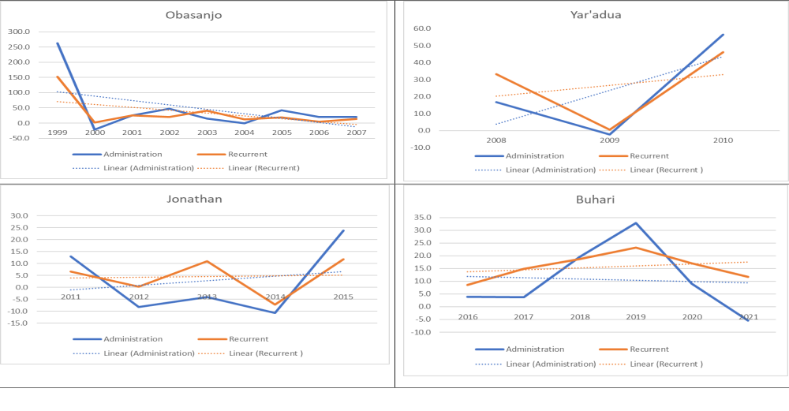
Trend in annual growth rate of administrative and recurrent expenditure by regime (1999-2021)

Slide 34
Personnel expenditure of political office holders
 | Number (1) | Annual Emolument (2) | Total 3(1X2)
President | 1 | 28,469,110.00 | 28,469,110.00
Vice president | 1 | 24,555,736.00 | 24,555,736.00
Minister/SGF/HOS/Chairman of Constitutional Bodies | 28 | 26,241,880.00 | 734,772, 640.00
Minister of State / Member of Constitutional Bodies | 16 | 606,751,921.00 | ?
Special Advisers | 159 | 7,091,493:75 | 1,127,538,801
SA to include other categories like Speech writer
DG/AG/PS/AG/ES/CE OF Parastatals, Agencies and Govt. Comp /INEC RECS |  | 7,414,580:25 | ?
CJN | 1 | 6,727,944:99 | 6,727,944.99
JSC/President, CoA |  | 10,899,284:00 | ?
JCoA/CJ, FHC/CJ, FCT/President, NIC, Grand Khadi FCT SCoA |  | 8,779,892;00 | ?
JoFHC/JoNIC/JoFCTHC/ JoSHC/ |  | 7,940,820:00 | ?

Slide 35
Personnel expenditure of political office holders (cont’d)
Senate President | 1 | 16,396,000.50 | 16,396,000.50
Deputy Senate President | 1 | 15,240,500.60 | 15,240,500.60
Senators | 107 | 29,180,160.00 | 3,122,277,120
Speaker, HoR | 1 | 12,633,261.00 | 12,633,261.00
Deputy Speaker, HoR | 1 | 11,723,874.67 | 11,723,874.67
Member, HoR | 358 | 25,609,259.31 | 9,168,114,722
SG | 1 | 14,676,453.00 | 14,676,453.00
DG |  | 7,392,752:50 | ?
SSG/COM./Chairman: SCSC/State JSC/JSC of FCT: State INEC/ LGSC; & CoS to Gov. |  | 4,880,871:25 | ?
SA/Member: SCSC/SJSC/JSC of FCT/State INEC/ LGSC |  | 4,562,901:50 | ?
DG/PS/AG/AUG/AUG for LG |  | 4,492,332:00 | ?
Total |  |  | 13,548,353,523.76

Slide 36
Gini coefficient (income inequality)

Slide 37
Life expectancy

Slide 38
GDP per capita (US$)

Slide 39
EFFECTS OF COST OF GOVERNANCE ON DEVELOPMENT

Slide 40
EFFECTS OF COST OF GOVERNANCE ON DEVELOPMENT

Slide 41
 | Dynamic Ordinary Least Square |  |  | Fully Modified Ordinary Least Square
Variable | GDPC | LE | GC | GDPC | LE | GC
Constant | 6.9393** (3.3693) | 4.0901*** (0.0504) | 3.4414*** (0.4272) | 2.1548 (1.4436) | 3.9226*** (0.0244) | 3.6698*** (0.1626)
AD | 0.2569** (0.1020) | -0.2208*** (0.0402) | 0.6165** (0.1673) | 0.0897 (0.2126) | -0.0256*** (0.0103) | 0.0442 (0.0743)
SC | 0.3522 (0.2212) | 0.1213** (0.0318) | 0.4221** (0.1244) | 0.0565 (0.1031) | 0.0134*** (0.0052) | 0.0104 (0.0358)
ES | -0.1797*** (0.0570) | 0.0287 (0.0173) | -0.1231 (0.0942) | -0.0102 (0.1118) | 0.0280*** (0.0093) | -0.0138 (0.0386)
GT | 0.3314 (0.2060) | 0.1072*** (0.0192) | -0.0142 (0.1398) | 0.0762 (0.1263) | 0.0252*** (0.0090) | -0.0969* (0.0527)
LF | 0.0740 (0.9247) |  |  | 0.7398* (0.4294)
INV | 0.1186** (0.0487) |  |  | 0.6543*** (0.1340)
CPI |  | -0.0998*** (0.0145) |  |  | -0.0313** (0.0117)
Poldum |  | -0.0833** (0.0256) |  |  | 0.1096*** (0.0091)
UMP |  |  | 0.1082 (0.2315) |  |  | 0.1457 (0.0945)
OIL |  |  | -0.2671** (0.0982) |  |  | 0.1038** (0.0407)
R-Squared | 0.9992 | 0.9939 | 0.9830 | 0.9945 | 0.9480 | 0.7250
Adj. R-squared | 0.9978 | 0.9637 | 0.8980 | 0.9935 | 0.8304 | 0.6735
Wald Test | 11102.57*** | 141533.5*** | 2373.78*** | 13638.51*** | 267436.6*** | 13827.42***
JB | [0.3521] | [0.3433] | [0.7477] | [0.6515] | [0.9719] | [0.1825]

Slide 42
 | Dynamic Ordinary Least Square |  |  | Fully Modified Ordinary Least Square
Variable | GDPC | LE | GC | GDPC | LE | GC
Constant | 6.9393** (3.3693) | 4.0901*** (0.0504) | 3.4414*** (0.4272) | 2.1548 (1.4436) | 3.9226*** (0.0244) | 3.6698*** (0.1626)
AD | 0.2569** (0.1020) | -0.2208*** (0.0402) | 0.6165** (0.1673) | 0.0897 (0.2126) | -0.0256*** (0.0103) | 0.0442 (0.0743)
SC | 0.3522 (0.2212) | 0.1213** (0.0318) | 0.4221** (0.1244) | 0.0565 (0.1031) | 0.0134*** (0.0052) | 0.0104 (0.0358)
ES | -0.1797*** (0.0570) | 0.0287 (0.0173) | -0.1231 (0.0942) | -0.0102 (0.1118) | 0.0280*** (0.0093) | -0.0138 (0.0386)
GT | 0.3314 (0.2060) | 0.1072*** (0.0192) | -0.0142 (0.1398) | 0.0762 (0.1263) | 0.0252*** (0.0090) | -0.0969* (0.0527)
LF | 0.0740 (0.9247) |  |  | 0.7398* (0.4294)
INV | 0.1186** (0.0487) |  |  | 0.6543*** (0.1340)
CPI |  | -0.0998*** (0.0145) |  |  | -0.0313** (0.0117)
Poldum |  | -0.0833** (0.0256) |  |  | 0.1096*** (0.0091)
UMP |  |  | 0.1082 (0.2315) |  |  | 0.1457 (0.0945)
OIL |  |  | -0.2671** (0.0982) |  |  | 0.1038** (0.0407)
R-Squared | 0.9992 | 0.9939 | 0.9830 | 0.9945 | 0.9480 | 0.7250
Adj. R-squared | 0.9978 | 0.9637 | 0.8980 | 0.9935 | 0.8304 | 0.6735
Wald Test | 11102.57*** | 141533.5*** | 2373.78*** | 13638.51*** | 267436.6*** | 13827.42***
JB | [0.3521] | [0.3433] | [0.7477] | [0.6515] | [0.9719] | [0.1825]

Slide 43
Model results discussion
DISAGGREGATED RECURRENT EXPENDITURE MODEL
DISAGGREGATED ADMINISTRATIVE EXPENDITURE MODEL
Development Indicator | Recurrent expenditure
GDP per capita | AD**, SC, GT (positive), ES*** (negative)
Life Expectancy | ES, SC**, GT*** (positive), AD*** (negative) Poldum** (negative)
Gini Coefficient (measure of inequality) | AD**, SC** (positive), ES, GT (negative)
Development Indicator | Recurrent expenditure
GDP per capita | GA** DF (positive), IS (negative)
Life Expectancy | GA***, IS** DF (positive), Poldum**(negative)
Gini Coefficient (measure of inequality) | GA**, DF** (positive), IS***(negative)

Slide 44
Respondents believe, on one hand, explained that there is high cost of governance in Nigeria and that the high cost of governance has affected the development of the country.
“The management of the fiscal system affects the management of the country’s monetary system. So the fiscal system undermines the monetary system, you know, it is like a cycle. And of course, once that happens there will be governments who are borrowing, the interest rate will go up, inflation rate will go up. Once inflation rises, cost of living goes up across the board”.(A respondent from the society realm in Osun State)
PROBLEM STATEMENT
MOTIVATION FOR STUDY
CONCEPTUAL FRAMEWORK
STAKEHOLDERS’ PERCEPTION
LITERATURE REVIEW
METHODOLOGY
EXPECTED OUTPUT
TIME FRAME AND BUDGET

Slide 45
Summary
The number of appointed ministers has never exceeded 50 across the various regimes since 1999.
The number of ministries average around 27, with nominal introductions of about four new ministries to what was inherited from the military in 1999.
The highest average growth rates of federal administrative and recurrent expenditure between 1999 and 2021 was recorded by the Obasanjo administration followed by Yar’adua, Buhari and Jonathan in that order.

Slide 46
Summary
Overall, the effects of disaggregated federal government spending on development in Nigeria are mixed.
Where GDP per capita and life expectancy are the measure of development, the cost of governance metrics improved development.
When a measure of inequality (Gini coefficients) is the indicator of development, cost of governance undermined development in Nigeria.

Slide 47
Recommendations
“Clean wage” practices - salaries and allowi should be clean and plain to the citizens and devoid of hidden charges.
Purge out low-priority expenditure programs, scale down entitlement programs.
Follow optimum efficiency principles in expenditure programming underpinned by rigorous cost-benefit analyses.
Digitalization strategy (uptake of DT) results innovation-inspired time and efficiency gains, narrow the scope for graft and enables e-accounting and e-auditing systems
Streamline, realign, MDAs and generally shrink government size
Fast track repeal of the enabling acts of the MDAs
Consider switching to a unicameral legislature and part-time legislator arrangements
Emoluments of political office holders should mimic those of career public servants

Slide 48


Slide 49
ANNEX
Year | Administration | Social and community service | Economic service | Government transfer | Gin Coefficient | Gross fixed capital formation (% of GDP) | Gross capital formation (current LCU) | Gross fixed capital formation (annual % growth) | Gross fixed capital formation (constant LCU) | Gross fixed capital formation (current LCU) | Gross capital formation (constant LCU) | Gross capital formation (annual % growth) | Labour force | General administration | Defence | Internal security
1981 | 0.91 | 0.29 | 0.18 | 3.46 | 50.535 | 89.38613 | 1.2452E+11 | .. | 1.57897E+13 | 1.25E+11 | 1.58E+13 | .. | 20.85 | 0.91
1982 | 1.04 | 0.33 | 0.20 | 3.93 | 50.006 | 85.9414 | 1.2809E+11 | -18.3402 | 1.28938E+13 | 1.28E+11 | 1.29E+13 | -18.346 | 21.52 | 1.04
1983 | 0.90 | 0.29 | 0.17 | 3.39 | 49.478 | 75.75651 | 1.2026E+11 | -20.9057 | 1.01983E+13 | 1.2E+11 | 1.02E+13 | -20.9021 | 22.21 | 0.90
1984 | 1.10 | 0.35 | 0.21 | 4.16 | 48.949 | 58.95629 | 9.7767E+10 | -30.1716 | 7.12128E+12 | 9.78E+10 | 7.12E+12 | -30.1846 | 22.92 | 1.10
1985 | 1.43 | 0.46 | 0.27 | 5.41 | 48.42 | 46.39545 | 8.7136E+10 | -15.2925 | 6.03226E+12 | 8.71E+10 | 6.03E+12 | -15.2823 | 23.65 | 1.43
1986 | 1.45 | 0.47 | 0.28 | 5.50 | 47.891 | 54.94827 | 1.0887E+11 | 0.218804 | 6.04546E+12 | 1.09E+11 | 6.05E+12 | 0.244621 | 24.41 | 1.45
1987 | 3.84 | 0.30 | 0.69 | 10.81 | 49.434 | 50.04989 | 1.2231E+11 | -6.22928 | 5.66887E+12 | 1.22E+11 | 5.66E+12 | -6.33705 | 25.19 | 3.84
1988 | 5.78 | 2.11 | 1.22 | 10.30 | 50.977 | 43.75477 | 1.3775E+11 | 6.68359 | 6.04775E+12 | 1.38E+11 | 6.03E+12 | 6.528742 | 25.99 | 5.78
1989 | 6.27 | 4.23 | 1.42 | 14.07 | 52.521 | 52.48744 | 2.1776E+11 | 6.517264 | 6.4419E+12 | 2.18E+11 | 6.44E+12 | 6.785273 | 26.82 | 6.27
1990 | 6.54 | 3.40 | 1.61 | 24.67 | 54.064 | 53.12219 | 2.6308E+11 | 13.80424 | 7.33116E+12 | 2.63E+11 | 7.34E+12 | 13.89385 | 27.38 | 6.54
1991 | 6.95 | 2.68 | 1.30 | 27.31 | 55.607 | 48.40018 | 2.8562E+11 | -1.2394 | 7.24029E+12 | 2.86E+11 | 7.24E+12 | -1.30247 | 27.94 | 6.95
1992 | 8.68 | 1.34 | 3.08 | 39.93 | 57.15 | 43.77439 | 3.9665E+11 | 0.512945 | 7.27743E+12 | 3.97E+11 | 7.28E+12 | 0.520135 | 26.3 | 8.68
1993 | 30.57 | 14.66 | 7.75 | 83.75 | 56.137 | 44.47636 | 5.593E+11 | 7.533617 | 7.82569E+12 | 5.59E+11 | 7.83E+12 | 7.562118 | 30.58 | 30.57
1994 | 20.54 | 10.09 | 3.91 | 55.44 | 55.123 | 42.06784 | 7.4437E+11 | -2.45882 | 7.63327E+12 | 7.44E+11 | 7.64E+12 | -2.45384 | 31.27 | 11.93 | 4.21 | 4.40
1995 | 28.76 | 13.82 | 5.92 | 79.13 | 54.11 | 37.20593 | 1.1545E+12 | -6.64314 | 7.12618E+12 | 1.15E+12 | 7.14E+12 | -6.57762 | 31.95 | 16.90 | 6.60 | 5.26
1996 | 47.12 | 17.69 | 5.84 | 53.64 | 53.096 | 36.58167 | 1.4965E+12 | 6.793911 | 7.61032E+12 | 1.49E+12 | 7.62E+12 | 6.832184 | 32.65 | 26.30 | 11.90 | 8.92
1997 | 56.18 | 22.06 | 6.20 | 74.12 | 52.082 | 38.42226 | 1.7002E+12 | 5.845782 | 8.05521E+12 | 1.7E+12 | 8.07E+12 | 5.877423 | 41.6 | 30.92 | 14.21 | 11.06
1998 | 50.68 | 21.44 | 11.57 | 94.40 | 50.423 | 40.5534 | 1.9516E+12 | 1.393454 | 8.16745E+12 | 1.95E+12 | 8.19E+12 | 1.425329 | 43.2 | 23.93 | 14.76 | 11.98
1999 | 183.64 | 71.37 | 87.08 | 107.58 | 48.763 | 38.278 | 2.102E+12 | 2.675391 | 8.38596E+12 | 2.1E+12 | 8.41E+12 | 2.703579 | 46.85 | 85.79 | 53.16 | 38.66
2000 | 144.53 | 84.79 | 28.59 | 203.69 | 47.103 | 34.04928 | 2.4091E+12 | 7.285385 | 8.99691E+12 | 2.4E+12 | 9.02E+12 | 7.303042 | 49.7 | 67.46 | 43.40 | 25.15
2001 | 180.80 | 79.63 | 53.01 | 265.86 | 45.443 | 30.03794 | 2.5466E+12 | -23.7467 | 6.86044E+12 | 2.47E+12 | 6.96E+12 | -22.7928 | 50.45 | 75.08 | 47.07 | 38.85
2002 | 266.51 | 152.19 | 52.95 | 225.15 | 43.783 | 26.76866 | 3.1724E+12 | 10.19303 | 7.55973E+12 | 3.08E+12 | 7.68E+12 | 10.30784 | 51.23 | 117.94 | 69.13 | 63.24
2003 | 307.97 | 102.61 | 96.07 | 477.65 | 42.123 | 28.3709 | 3.984E+12 | 21.40866 | 9.17817E+12 | 3.85E+12 | 9.34E+12 | 21.51552 | 52.68 | 166.12 | 51.06 | 68.38
2004 | 306.80 | 134.40 | 58.90 | 610.70 | 40.463 | 26.06325 | 4.9149E+12 | -19.9368 | 7.34834E+12 | 4.72E+12 | 7.54E+12 | -19.1828 | 53.7 | 101.30 | 76.30 | 97.80
2005 | 434.70 | 151.70 | 64.20 | 670.70 | 39.844 | 24.96612 | 6.0555E+12 | 2.342505 | 7.52047E+12 | 5.77E+12 | 7.79E+12 | 3.252904 | 56.82 | 248.70 | 71.70 | 82.00
2006 | 522.30 | 194.20 | 79.70 | 594.00 | 39.224 | 26.1665 | 8.4642E+12 | 40.38866 | 1.05579E+13 | 7.95E+12 | 1.1E+13 | 40.74386 | 58.31 | 284.60 | 84.20 | 118.00
2007 | 626.36 | 256.67 | 179.07 | 527.17 | 38.604 | 20.18004 | 7.3668E+12 | -21.8953 | 8.24621E+12 | 7E+12 | 8.6E+12 | -21.5497 | 60.01 | 310.11 | 72.10 | 181.29
2008 | 731.02 | 332.93 | 313.75 | 739.66 | 37.984 | 18.85977 | 7.9497E+12 | -2.60106 | 8.03172E+12 | 7.54E+12 | 8.42E+12 | -2.12357 | 62.07 | 369.53 | 95.85 | 196.90
2009 | 714.42 | 354.19 | 423.61 | 635.75 | 37.364 | 21.11545 | 9.583E+12 | 9.924205 | 8.82881E+12 | 9.18E+12 | 9.22E+12 | 9.564519 | 63.15 | 437.93 | 54.84 | 221.65
2010 | 1,117.44 | 550.90 | 562.75 | 878.34 | 36.744 | 16.81501 | 9.5911E+12 | 4.01246 | 9.18306E+12 | 9.18E+12 | 9.59E+12 | 3.978189 | 65.17 | 694.54 | 198.71 | 224.20
2011 | 1,262.40 | 785.44 | 310.50 | 956.18 | 36.124 | 15.67631 | 1.0329E+13 | -8.24668 | 8.42576E+12 | 9.9E+12 | 8.83E+12 | -7.91501 | 67.3 | 699.20 | 283.20 | 280.00
2012 | 1,159.40 | 790.06 | 230.10 | 1,145.60 | 36.051 | 14.21112 | 1.0823E+13 | 2.551734 | 8.64077E+12 | 1.03E+13 | 9.13E+12 | 3.359867 | 68.68 | 500.10 | 296.80 | 362.50
2013 | 1,111.80 | 844.10 | 291.20 | 1,441.90 | 35.978 | 14.16873 | 1.2074E+13 | 7.864836 | 9.32035E+12 | 1.15E+13 | 9.84E+12 | 7.816524 | 70.07 | 546.80 | 272.30 | 292.70
2014 | 992.84 | 774.77 | 266.40 | 1,392.93 | 35.906 | 15.08353 | 1.4244E+13 | 13.42649 | 1.05717E+13 | 1.36E+13 | 1.11E+13 | 12.98638 | 71.295 | 445.17 | 274.53 | 273.14
2015 | 1,228.99 | 807.59 | 275.36 | 1,520.01 | 35.833 | 14.82718 | 1.4743E+13 | -1.3197 | 1.04322E+13 | 1.41E+13 | 1.09E+13 | -1.5344 | 54.55723 | 488.20 | 330.59 | 410.20
2016 | 1,277.00 | 775.55 | 255.78 | 1,851.77 | 35.76 | 14.72496 | 1.5762E+13 | -4.8405 | 9.92726E+12 | 1.51E+13 | 1.04E+13 | -4.66855 | 55.28597 | 479.18 | 380.17 | 417.66
2017 | 1,324.30 | 931.68 | 334.89 | 2,189.12 | 35.687 | 14.71562 | 1.778E+13 | -2.97726 | 9.6317E+12 | 1.69E+13 | 1.02E+13 | -1.82955 | 57.85616 | 564.42 | 361.92 | 397.95
2018 | 1,584.06 | 1,083.73 | 372.55 | 2,634.86 | 35.614 | 19.01838 | 2.5577E+13 | 9.73767 | 1.05696E+13 | 2.46E+13 | 1.12E+13 | 9.384233 | 60.51705 | 652.26 | 442.15 | 489.65
2019 | 2,105.20 | 1,393.56 | 479.03 | 3,019.41 | 35.541 | 24.62523 | 3.7015E+13 | 8.290431 | 1.14459E+13 | 3.59E+13 | 1.19E+13 | 6.320929 | 63.22672 | 847.57 | 588.99 | 668.63
2020 | 2,294.72 | 1,519.02 | 522.15 | 3,852.93 | 35.541 | 26.7442 | 4.2415E+13 | -14.7159 | 9.7615E+12 | 4.13E+13 | 1.03E+13 | -13.8981 | 62.24296 | 923.88 | 642.01 | 728.83
2021 | 2,168.45 | 1,438.07 | 495.32 | 5,043.30 |  | 33.10736 | 5.9575E+13 | 4.664448 | 1.02168E+13 | 5.83E+13 | 1.07E+13 | 4.391968 |  | 875.96 | 612.53 | 679.96

